Slide 1
DFBI tractography connectivity pipeline
Preprocessing and connectivity matrix generation
Chris Adamson

Slide 2
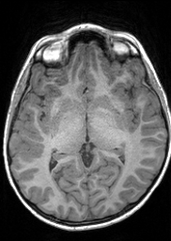
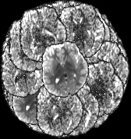
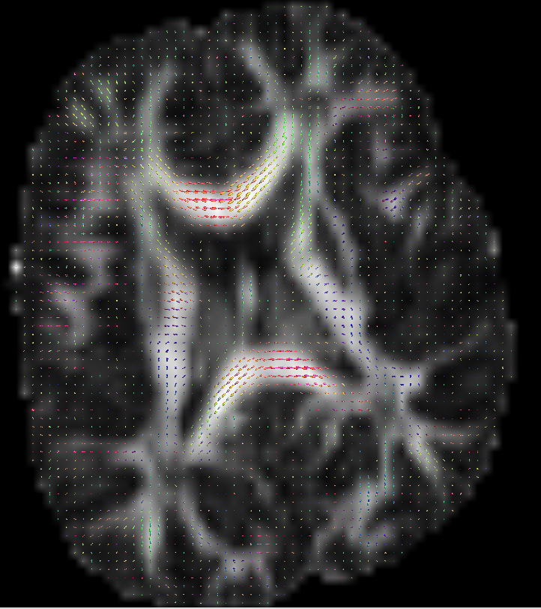
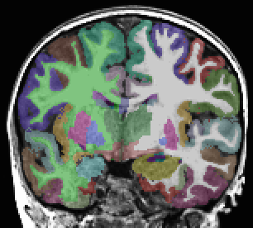
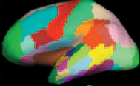
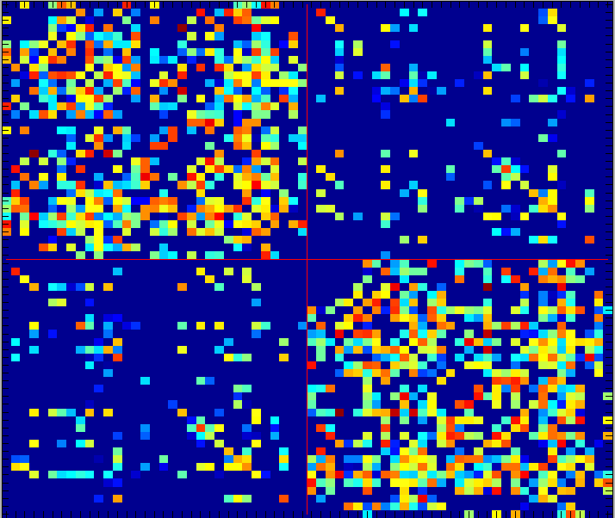
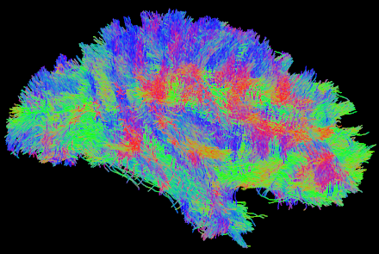
T₁ image
DWI images
Preprocessing pipeline
Parcellation into anatomical ROIs
DWI preprocessing
Register T₁ to DWI space
T₁ to DWI space transform
Tractography and connectivity matrix construction

Slide 3
The preprocessing pipeline
Step | Description | Modalities | Dependencies
1 | Reorient DWI and T1 and crop T1 | DWI, T1
2 | Run Freesurfer | T1 | 1
3 | Bias correct T1 and skull strip | DWI, T1 | 1
4 | Eddy current correction of DWI | DWI | 1
5 | Register b=0 to T1 nonlinear | DWI, T1 | 3
6 | Run DWI preprocessing and CSD | DWI | 3, 4
7 | Transform Freesurfer output to DWI space | T1 | 5
8 | Generate tractography seeds | T1 | 7
 | Cortical parcellation
 | Register DWI to T1
 | DWI preprocessing

Slide 4

Set up – directory structure
Root
dwi_good_ids.txt: Text file, each line is a subject ID
For example, dwi_good_ids.txt has
foo1
foo2
Then the data in the raw directories would be:
RawDWI: diffusion weighted images and gradient tables
foo1.nii.gz, foo1.grad
foo2.nii.gz, foo2.grad
RawT1: T1 structural images
foo1.nii.gz
foo2.nii.gz

Slide 5
Step 1: Reorient images
Reorient T₁ and DWI images to canonical orientation: x=Sagittal, y=Coronal, z=Axial
Automatic detection and preservation of radiological/neurological orientation
Symbolic links created in output directories if no reorientation is required

Slide 6
Step 1: Automatic neck cropping of T₁ images
Improves skull stripping
More of the image is occupied by the brain
Chris’ algorithm
Use Otsu thresholding to separate foreground/background.
Crop 180mm from most superior foreground slice.
Register to FSL average T₁.
Transform FSL average brain mask to T₁.
Crop at most inferior slice with average brain mask “signal”.
Richard’s algorithm

Slide 7
Step 1: Automatic neck cropping of T₁ images - results
Sometimes most inferior slices of cerebellum are lost sorry Lil

Slide 8
Step 1: Quality control
Step1qc script runs slicesdir

Slide 9
Step 2: Freesurfer
Create Freesurfer directory structure
Convert T₁ images to mgz
Run recon-all

Slide 10
Step 3: Skull Strip T₁
Run N4 to perform bias correction
Then BET
Other methods for this exist
Once neck is removed BET does a good job generally
Non-removal of dura mater causes artefactual expansion of cortical regions

Slide 11
Step 3: Skull Strip b₀
Skull stripping b₀ images is easier
  b₀ images have limited signal from scalp and neck
  Less non-brain is covered in DWI images
BET with a conservative threshold f=0.2 seems to work well in all cases I have seen

Slide 12
Step 4: Eddy Correct DWI
Runs eddy_correct on DWI image
Assumes first image is b₀ image
Uses traditional linear alignment

Slide 13
Step 5: Register b₀ to T₁
Skull stripped b0 images are registered to skull stripped and “contrast-inverted” T₁ images
  Linear with FLIRT then
  Non-linear with ANTS
    Requires skull stripped images for best results

Slide 14
Step 5: Register b0 to T₁ quality control
Slices is run on each registered image with linear and non-linear registrations
Verify by looking at the images

Slide 15
Step 6: Perform CSD
Copy eddy corrected DWI image to mrtrix directory
Run mrtrix pipeline based on instructions from mrtrix website, basically
Issues
  Outlier detection
  Bad slice removal

Slide 16
Step 7: Transform from T₁ space to DWI space
Invert transformations computed by FLIRT and ANTS on aparc, aparc.a2009s images
When inverting the linear transformation, images are not resampled, their voxel to world transformation is changed
Mrtrix can use seeds in T₁ resolution

Slide 17
Step 8: Generate tractography images
Extract ROI labels from Freesurfer parcellation schemes for tractography
  Remove non-ROI labels from seed images
  Generate white matter mask
  Generate exclusion region image
Notes:
Put images from website here for the seeds

Slide 18
Parcellation schemes
Freesurfer parcellation schemes
  APARC: 34 regions per hemisphere
  APARC.a2009s: 75 regions per hemisphere
Explain customisation method
  Text files are in lib/parc_schemes
  Show examples…
  APARC_ADS: APARC + a few subcortical nuclei

Slide 19
Tractography and connectivity matrix generation
MATLAB script
Mrtrix_create_tracks_wb_wm(Subject, MrtrixType, SeedType, Curvature)
  Subject (string): ID of the subject
  MrtrixType (string): tracking algorithm
  SeedType (string): set of ROIs to use
  Curvature (float): radius of curvature, smaller will allow more bending of streamlines
Executed from mrtrix directory

Slide 20
Tractography output
Connectivity mat file
  CountA
  LengthA
  WeightedA
  SizeWeightedCountA
Tck and trk files
Seed count image

Slide 21
Issues
Outlier detection/removal in CSD – mostly solved
Geometric distortion correction for DWI images – mostly solved but … tracking should be done in undistorted space
Culling false streamlines – some headway made here
Setting parameters for tractography????

